Slide 1



Slide 2
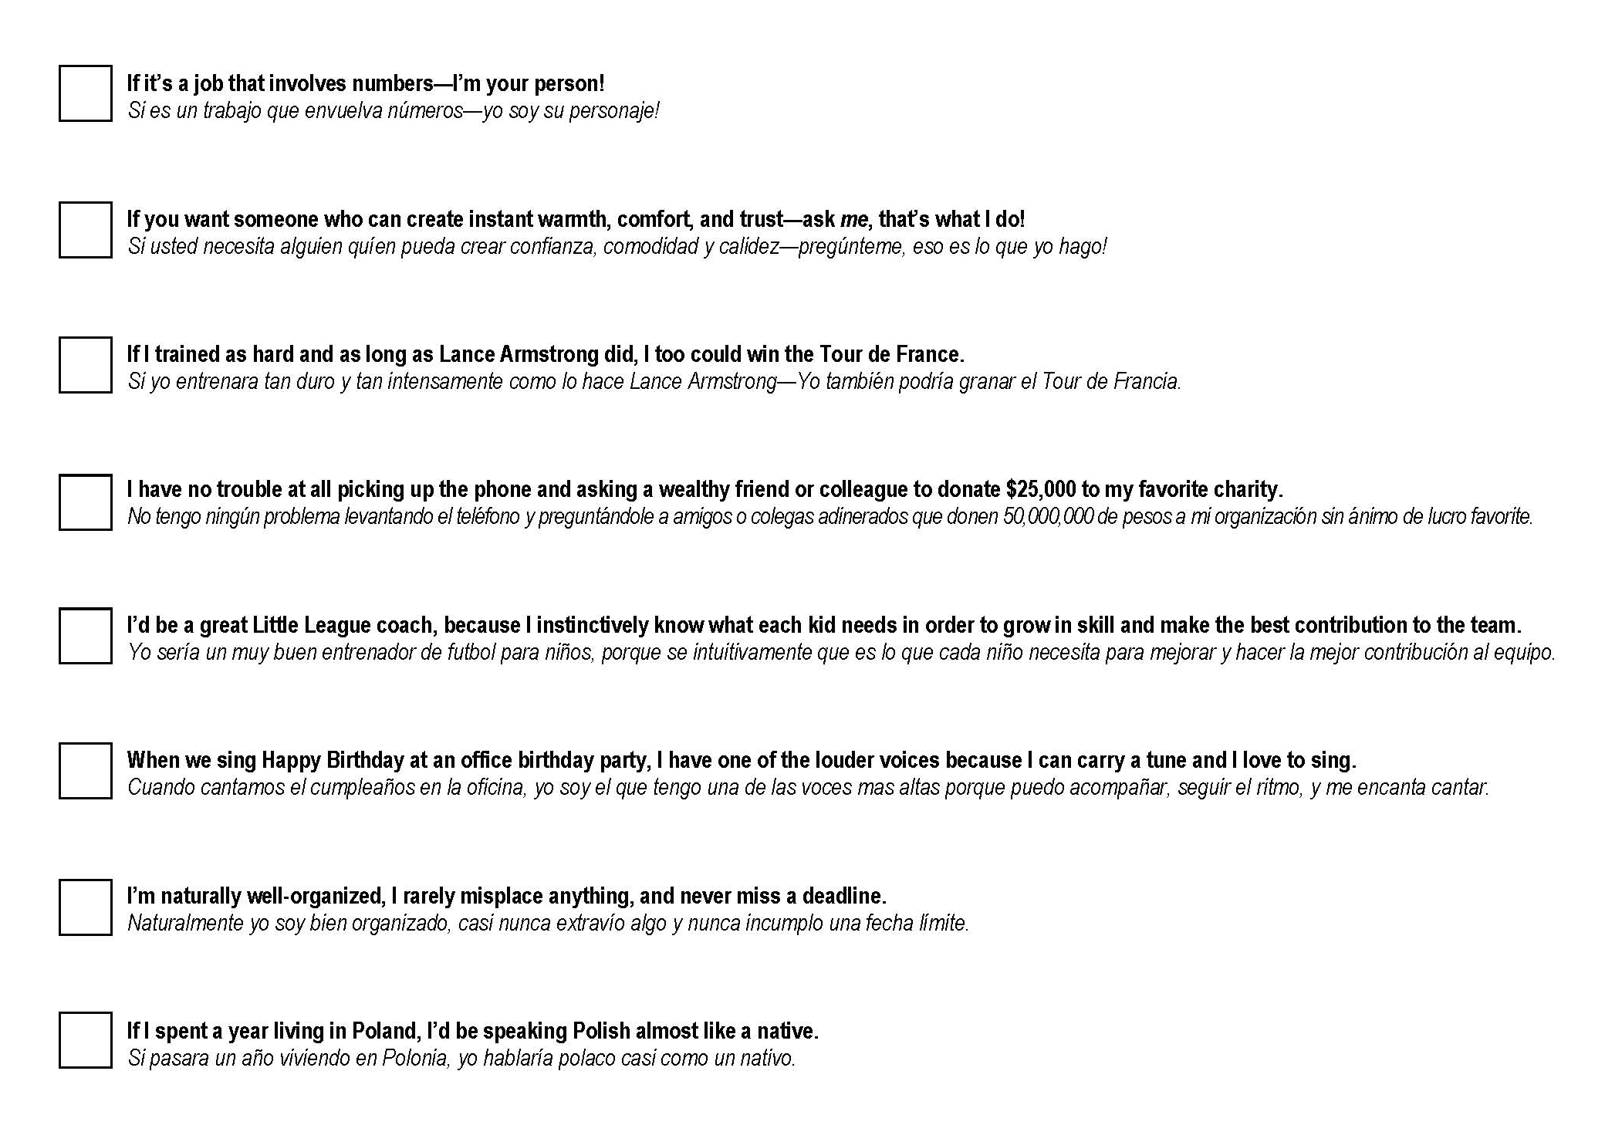

Slide 3

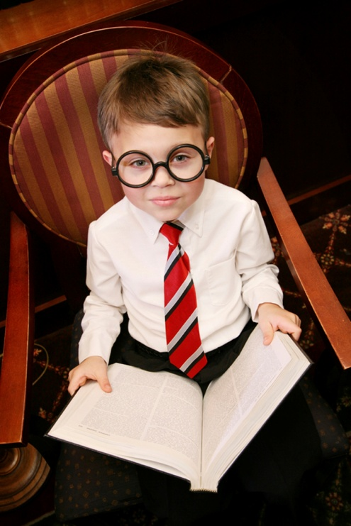


Satisfaction
Glimpses of excellence
Yearnings
Rapid Learning

Slide 4
8
2

Slide 5
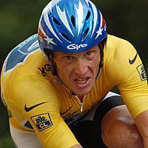
“If I trained as hard as Lance Armstrong did, I too could win the Tour de France.”

Slide 6
Training?
Talent

Slide 7
Talent
Training

Slide 8

Talent
Turning Talent into Performance
The CSS Management Sphere of Influence

Slide 9
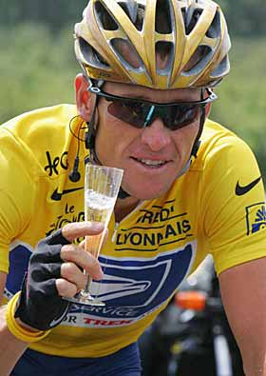
Lance was born different...
Genetics:
Heart rate 200 beats/minute.
VO₂ rate off the charts.
Lowest level of lactic acid in muscles ever recorded in a human being.
Cancer-conquering drive.
Training:
Increased is muscle efficiency by 8%, a feat never seen before.
Increased his pedal rate from 85 to 105 revolutions per minute.

Slide 10
Lance was born different...
Nature:
Heart rate 200 beats/minute.
VO₂ rate off the charts.
Lowest level of lactic acid in muscles ever recorded in a human being.
Cancer-conquering drive.
Nurture:
Increased is muscle efficiency by 8%, a feat never seen before.
Increased his pedal rate from 85 to 105 revolutions per minute.

Slide 11
Lance was born different...
Talent:
Heart rate 200 beats/minute.
VO₂ rate off the charts.
Lowest level of lactic acid in muscles ever recorded in a human being.
Cancer-conquering drive.
Development:
Increased is muscle efficiency by 8%, a feat never seen before.
Increased his pedal rate from 85 to 105 revolutions per minute.

Slide 12
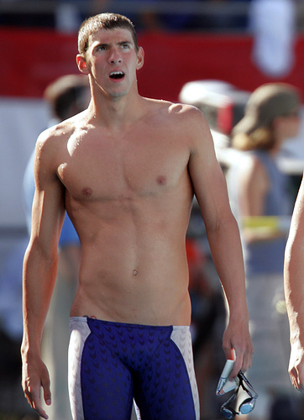
6’4” tall.
30” inseam.
6’7” wingspan.
Fingertips dangle near his knees.
Double-jointed knees.
Size 14 feet.
Post-race lactate levels = resting levels in others.
Gangly and uncoordinated on land.

Slide 13
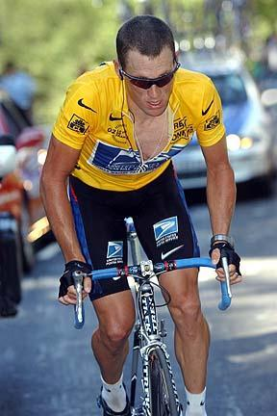
Director of Technology?
Director of Purchasing?

Slide 14

What are you
born to do?

Slide 15
What can you do
almost perfectly?

Slide 16
Talent is…
the capacity for a near-perfect performance.
—Dr. William Hall

Slide 17

Talent is…
the capacity for a near-perfect performance.
—Dr. William Hall
Talent is…
that portion of a person’s performance that cannot be explained by training or experience.

Slide 18
My non-talents
Most of us don’t have most talents.

Slide 19
But we’re all gems.
Our job as managers is not to put in what God left out—but to bring out what God put in.

Slide 20
Here’s why...
10x
STRENGTH
10%
NON-STRENGTH

Slide 21
In almost all endeavors, you and I have room for improvement.
In only certain endeavors, do we have potential for improvement.

Slide 22
ROOM
POTENTIAL
for improvement
for improvement
Focus on potential.

Slide 23
Focus on potential when managing yourself.
Find out what you don’t do well…

Slide 24
Focus on potential when managing yourself.
Find out what you don’t do well…
and don’t do it!
—TV character Alf

Slide 25
Focus on potential when managing others.
Don’t try to teach a pig to sing…

Slide 26
Focus on potential when managing others.
Don’t try to teach a pig to sing…
it wastes your time

Slide 27
Focus on potential when managing others.
Don’t try to teach a pig to sing…
it wastes your time
and it annoys the pig.

Slide 28
Focus on potential when managing others.
selecting

Slide 29
PERSON
JOB
Fit the person to the job.
Or fit the job to the person.

Slide 30
For a jumping dog act…
…hire dogs that jump a lot.
For a service with a smile…
…hire people who smile a lot.

Slide 31
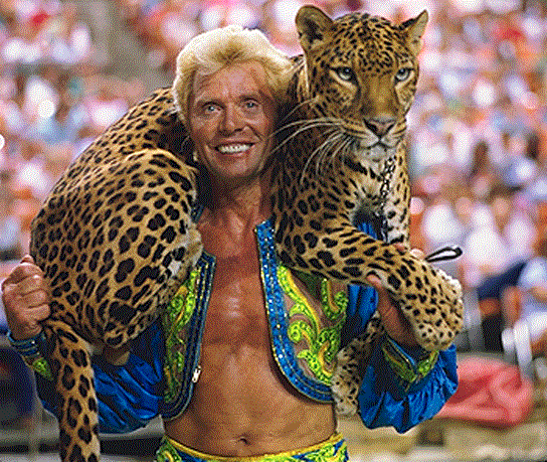
For a jumping dog act…
…hire dogs that jump a lot.
“They show us the thing they want us to do in performance. We work up routines with them, based on their natural behaviors. We can’t make them do anything they don’t want to do.”
—Gunther Gebel-Williams
For a service with a smile…
…hire people who smile a lot.

Slide 32
For a jumping dog act…
…hire dogs that jump a lot.
For a service with a smile…
…hire people who smile a lot.

Slide 33
10x
EXPONENTIAL
10%
MARGINAL

Slide 34



Hound.
Bribe.
Threaten.

Slide 35

When the fit is perfect,
they perform even when you’re not looking!

Slide 36
In the real world, the fit isn’t always perfect.
That’s what
managers
are here for!

Slide 37
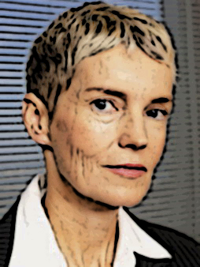
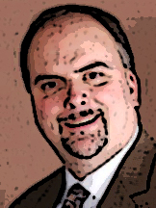


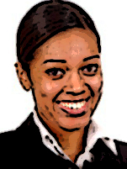
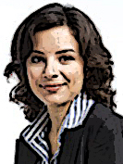
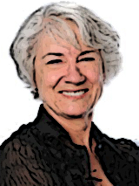
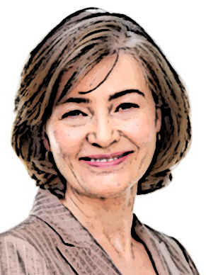
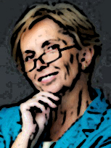
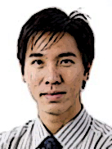
M
Susan
M
Henry
S
Jon
M
Tony
S
Chandra
S
Carol
M
Barbara
M
Sonia
S
Melissa
S
Jeremy

Slide 38
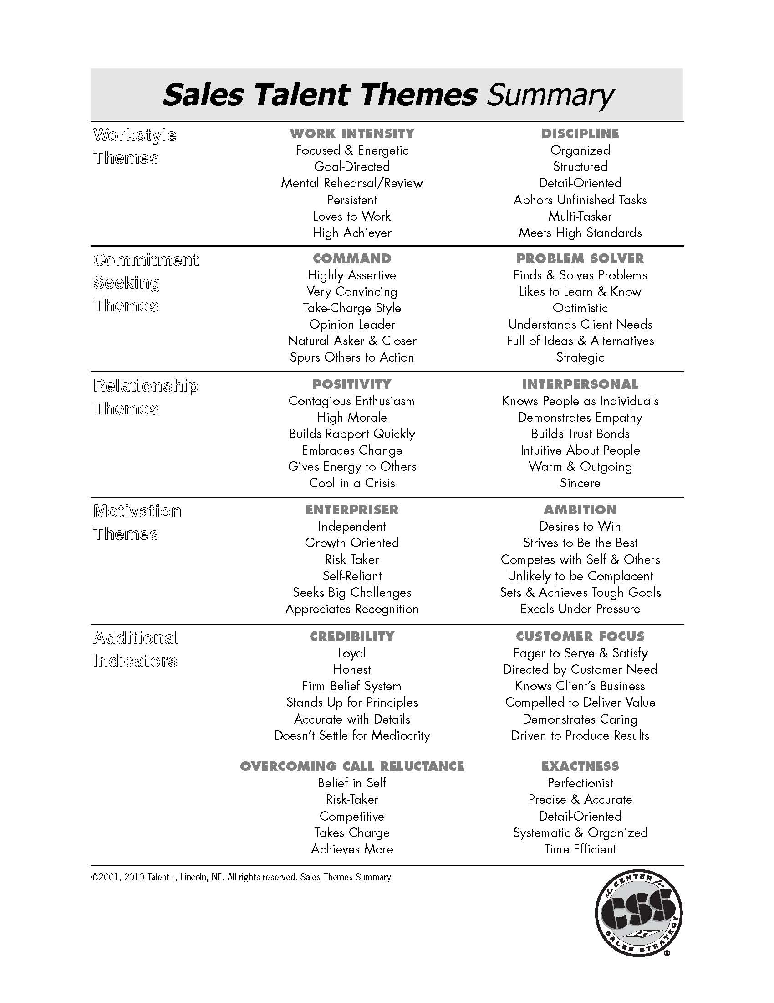
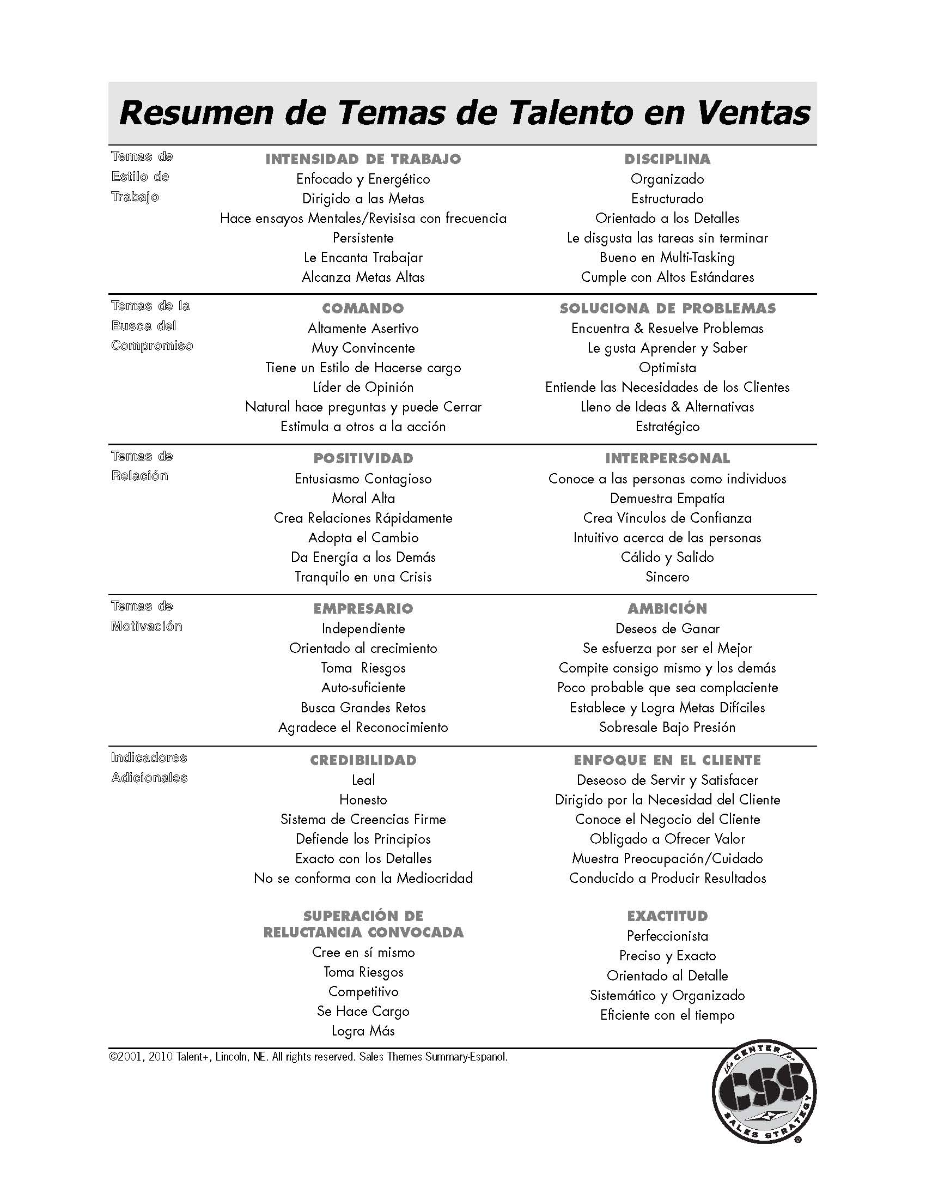

Slide 39
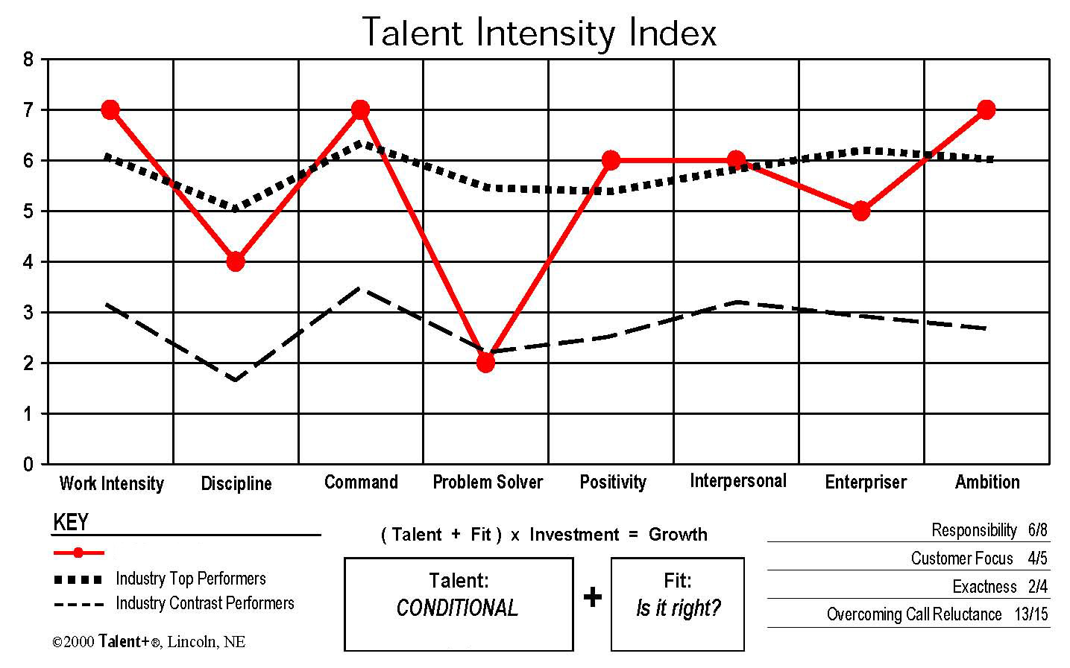
47
22

Slide 40

Selecting Talent
Turning Talent into Performance
Match their Talents to your Expectations.
Match your Expectations to their Talents.

Slide 41
If it’s a problem, you can’t fix it!
Instead, find a workaround…
based on a strength.
If the non-strength is a non-problem, just ignore it!

Slide 42
M
Susan
M
Henry
S
Jon
M
Tony
S
Chandra
S
Carol
M
Barbara
M
Sonia
S
Melissa
S
Jeremy

Slide 43
New to sales in 2006.
Quickly became proficient.
But specialized in small accounts with small potential.
M
Henry
S
Chandra
Henry sees her talent and knows he can help.

Slide 44
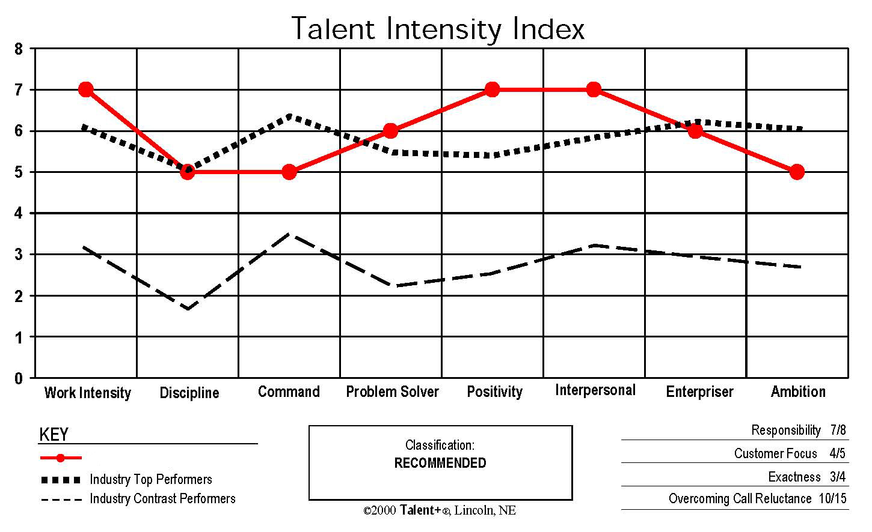
This is what Henry has to work with. Anything else is wishful thinking.
S
Chandra
48

Slide 45
This is what Henry has to work with. Anything else is wishful thinking.
Works long and hard, loves to practice and rehearse.
S
Chandra
48

Slide 46
This is what Henry has to work with. Anything else is wishful thinking.
Detail-oriented—even detail-needy.
S
Chandra
48

Slide 47
This is what Henry has to work with. Anything else is wishful thinking.
Finds it tough to grow accounts and to move stalled accounts.
S
Chandra
48

Slide 48
This is what Henry has to work with. Anything else is wishful thinking.
Strong on needs analysis, creative, creates strong proposals.
S
Chandra
48

Slide 49
This is what Henry has to work with. Anything else is wishful thinking.
Engaging, cheerful, builds rapport easily, appreciates recognition.
S
Chandra
48

Slide 50
This is what Henry has to work with. Anything else is wishful thinking.
Needs strong relationship with manager, feels every client is worth her time.
S
Chandra
48

Slide 51
This is what Henry has to work with. Anything else is wishful thinking.
Money-motivated, has strong desire to feel independent.
S
Chandra
48

Slide 52
This is what Henry has to work with. Anything else is wishful thinking.
Not a strength, but Chandra has other reasons to perform.
S
Chandra
48

Slide 53
Henry sees Chandra’s relationship magic—how it helps her, how it hurts her.
In the field, Henry sees:
Invests too much time in small accounts that cannot grow.
Fails to leverage her relationship magic to expand influence.
Reluctant to ask tough questions that lead to better sales.
Reluctant to close, fearing rejection and loss of relationship.
S
Chandra

Slide 54
Henry focuses first on his own relationship with Chandra.
Bases relationship on recognition and stimulating work environment.
Visits Chandra at her desk, rather than in his office.
Spends lots of time with Chandra in the field, on sales calls, where he can recognize her achievements in real time.
M
Henry

Slide 55
Henry appeals to Chandra’s desire to grow her income by helping her get in front of higher-value prospects.
Sensitive to her desire for independence, he does this in the office, not in the field.
He peppers Chandra with questions before approving a new Target Account—to ensure it’s a strong prospect.
M
Henry

Slide 56
To leverage Chandra’s relationship magic, he shows her how to expand her sphere of influence.
He mentions specific people he knows she has met and engages her in discussion as to how she’ll advance those business relationships.
He further leverages her relationship strength by pairing her with a sales rep from another division for team selling.
M
Henry

Slide 57
Henry notes both that Chandra likes to feel independent and likes to close business by herself—and that she enjoys practicing and rehearsing.
As a result, Henry is able to help prepare Chandra, in the office, for an upcoming close in the field. This builds her confidence and activates her otherwise softer Command.
In a similar fashion, he leverages her strong Customer Focus by showing Chandra how asking tough, probing questions will help her clients.
M
Henry

Slide 58
Performance turnaround!
After three years on the job, Chandra was still selling mostly small accounts—$2,000-3,000.
After Henry’s strengths-based coaching program, Chandra rocketed to #3-ranked Key Account developer on his staff.
Key Accounts are those over $24,000.
S
Chandra
M
Henry

Slide 59
Off to a roaring start in boom year 2007.
Slowdown in late 2008 sent Carol’s revenue down 35%.
M
Tony
S
Carol
Tony didn’t want to lose her (talent is hard to find!), so he committed himself to a strengths-based coaching program.

Slide 60
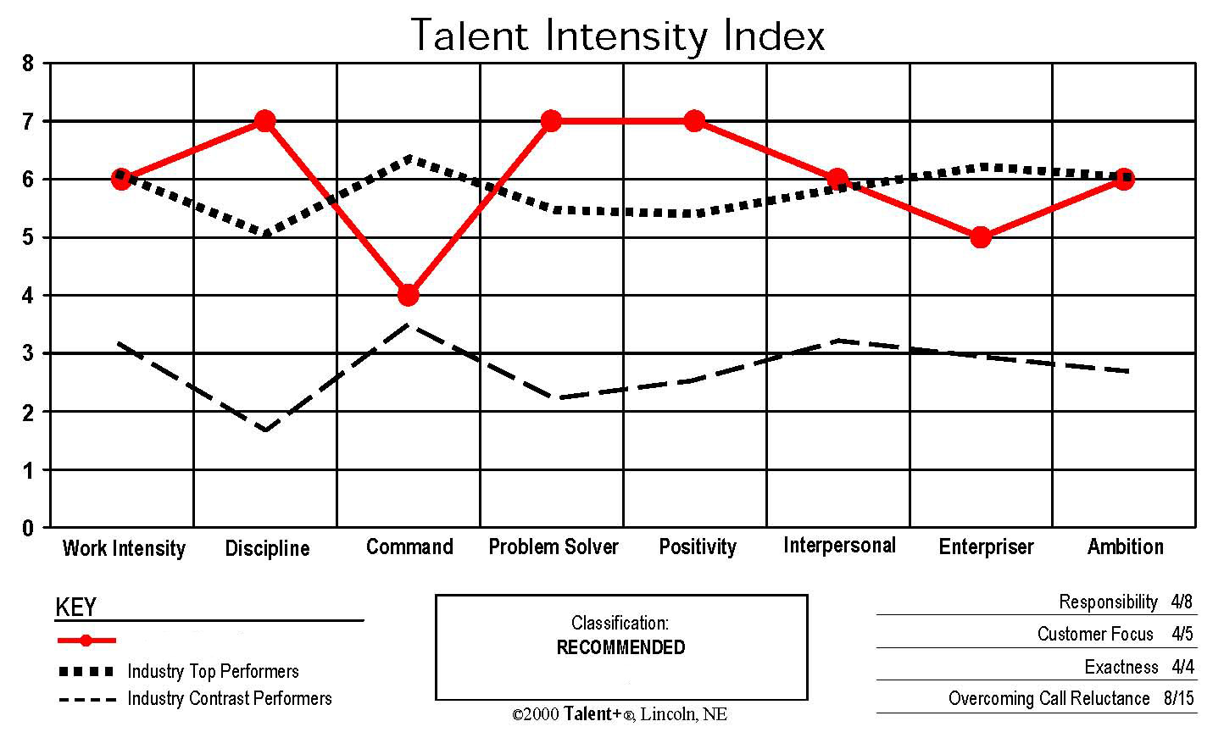
This is what Tony has to work with. Anything else is wishful thinking.
S
Carol
48

Slide 61
This is what Tony has to work with. Anything else is wishful thinking.
Hard-working, goal-driven.
S
Carol
48

Slide 62
This is what Tony has to work with. Anything else is wishful thinking.
Excellent work habits, strong drive for quality.
S
Carol
48

Slide 63
This is what Tony has to work with. Anything else is wishful thinking.
Clearly not a strength—especially in comparison to most others.
S
Carol
48

Slide 64
This is what Tony has to work with. Anything else is wishful thinking.
Asks great questions, makes good observations, analyzes situations accurately.
S
Carol
48

Slide 65
This is what Tony has to work with. Anything else is wishful thinking.
Highly resilient, rarely ever down in the dumps.
S
Carol
48

Slide 66
This is what Tony has to work with. Anything else is wishful thinking.
Strong relationships, prefers and is best 1-on-1, responds to a nurturing manager.
S
Carol
48

Slide 67
This is what Tony has to work with. Anything else is wishful thinking.
Sets high goals.
S
Carol
48

Slide 68
This is what Tony has to work with. Anything else is wishful thinking.
Very competitive, loves being measured, has to feel like she’s winning.
S
Carol
48

Slide 69
Carol’s Command is soft—and made all the worse by two enormous strengths.
Quality, perfection.
Highly analytical.
S
Carol
48

Slide 70
Carol’s Command is soft—and made all the worse by two enormous strengths.
In the field, Tony sees the soft Command causing…
Uncomfortable asking others to act—so fewer asks.
Would rather not ask Tony for help.
Often quiet in meetings where several others are present.
Low frequency of calls to set appointments.
S
Carol

Slide 71
Uncomfortable asking others to act.
Tony leverages Carol’s Discipline and Problem Solver talents by teaching her the mini-closing system, which breaks the big close down into successive smaller closes.
M
Tony

Slide 72
Would rather not ask Tony for help.
Tony realizes he had to be the proactive one… so he starts asking Carol about everything.
She appreciates the attention and it spurs the relationship.
He asks for her observations and analysis, as well as what steps she thinks she should take next—leveraging her Problem Solver talent.
The discussion about next steps creates an expectation that Carol will follow through and not let him down—which her strengths in Discipline and Interpersonal.
M
Tony

Slide 73
Often quiet in meeting where several others are present.
Rather than trying to goad her into speaking up in meetings, Tony encourages Carol to build more 1-on-1 relationships with more decision-influencers at each account.
This not only leverages her Interpersonal strength, but it’s also a superior way to nail a complex sale.
M
Tony

Slide 74
Low frequency of calls to set appointments.
Wisely, Tony makes no effort to increase Carol’s quantity of calls.
Noting her consistent drive for quality and perfection, he focuses on call quality, not call quantity.
He teaches her how to use the Ideal Customer Profile to target superior prospects… and how to research the prospect in advance in order to develop a Valid Business Reason that makes the call more likely to result in success.
These practices leverage Carol’s strength in Work Intensity, Discipline, and Problem Solver—and go a long way to alleviating her call reluctance.
M
Tony

Slide 75
Tony also taps into Carol’s solid Ambition theme.
He talks about the company’s goals and Carol’s goals.
He shows her what levels of activity and achievement it takes to be a winner.
He provides frequent measurement.
He shows her the small wins she is having along the way to her big wins.
M
Tony

Slide 76
Performance turnaround!
Carol’s history was to bounce along with the economy—having success in flush times, but trouble in tough times.
2008 revenue: $461,000.
Going into 2009, her annual contracts alone were down by $162,000.
With Tony’s coaching interventions, Carol finished 2009 with a 21% gain to $558,000—in an economy that continued to be in free fall.
S
Carol
M
Tony

Slide 77
Was first hired by the manager of a different sales team.
After 9 months, that manager was ready to give up.
M
Susan
S
Jon
Susan saw how hard Jon was working and his many other strengths… and was willing to take on the challenge. So Jon moved on to her team.

Slide 78
This is what Susan has to work with. Anything else is wishful thinking.
S
Carol
S
Jon
44

Slide 79
This is what Susan has to work with. Anything else is wishful thinking.
Loves to work, never slacks off, can be pushed to do more.
S
Carol
S
Jon
44

Slide 80
This is what Susan has to work with. Anything else is wishful thinking.
Not a great strength, is most productive when someone else lays out a path for him.
S
Carol
S
Jon
44

Slide 81
This is what Susan has to work with. Anything else is wishful thinking.
Major strength—great closer, natural leader, very assertive.
S
Carol
S
Jon
44

Slide 82
This is what Susan has to work with. Anything else is wishful thinking.
Major weakness—not curious or inquisitive, doesn’t have ideas/solutions for clients.
S
Carol
S
Jon
44

Slide 83
This is what Susan has to work with. Anything else is wishful thinking.
Loves to network, welcomes and enjoys change, gets others enthused/excited.
S
Carol
S
Jon
44

Slide 84
This is what Susan has to work with. Anything else is wishful thinking.
Builds solid relationships, seeks strong relationship with his manager.
S
Carol
S
Jon
44

Slide 85
This is what Susan has to work with. Anything else is wishful thinking.
Stimulated by growth goals, loves specific challenges, money-motivated.
S
Carol
S
Jon
44

Slide 86
This is what Susan has to work with. Anything else is wishful thinking.
Very competitive, likes contests, goal-oriented, always wants to be the best.
S
Carol
S
Jon
44

Slide 87
Problem Solver is what stands between Jon and a performance turnaround.
Susan sees how Jon’s low Problem Solver undermines him…
Poor needs analysis; doesn’t ask many questions; jumps on the first need he hears whether it’s a good biz oppty or not.
Back at the office, Jon is unclear how to develop a solution.
Has fallen into the habit of looking for sales, not needs. Selling packages instead of solutions, his sales were small.
S
Carol
S
Jon

Slide 88
Susan has taken on a very big challenge!
Jon has many impressive strengths, but none of them is a workaround for his very low Problem Solver.
The workaround here must be found in another person.
In Susan’s organization, there is no one other than herself who can be relied upon to function as Jon’s Problem Solver.
So she is committed to doing this for as long as she is the sales manager and Jon is on her team.
M
Susan

Slide 89
Susan invites Jon to come to her whenever he needs help, promising to be his sounding board.
She spends time with Jon before every needs-analysis appointment, working on good questions to ask.
She debriefs him after every important call, to help Jon figure out what he learned and what to do next.
And Susan leads brainstorming sessions with Jon to develop ideas and solutions he can propose to the prospect.
M
Susan

Slide 90
Susan also focuses on Jon’s Ambition theme.
She identifies his biggest personal goals—to put his two kids through college over the next few years.
She uses this to increase his activity and improve the quality of his prospects, showing him how doing so will help him reach his goals.
And she presses Jon’s competition ‘buttons’ by talking about how other sellers on the team are performing.
M
Susan

Slide 91
Performance turnaround!
Before Susan took over management of Jon, his biggest account was $6,000 and he ranked dead last on the sales team.
In a little over a year, Jon’s myriad strengths—together with Susan’s Problem Solver theme—caused him to leap over many of his colleagues… and he now ranks 3rd or 4th depending on the month.
And he just closed a $70,000 account.
S
Jon
M
Susan

Slide 92
S
Jon
M
Susan
But what about Susan?
It’s a big time commitment.
She has other salespeople to manage.
Jon is not likely to improve in Problem Solver talent.
Does this make sense?
This man has a lot to smile about.

Slide 93
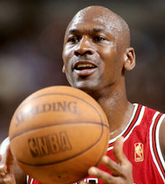
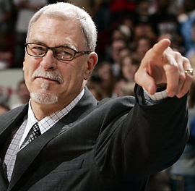
Very talented young man—but talent alone is not enough.
M
Sonia
S
Jeremy

Slide 94
Very talented young man—but talent alone is not enough.
And Jeremy’s toughest performance challenge turned out to be, not his biggest weakness, but his biggest strength.
M
Sonia
S
Jeremy
Sonia conferred with the talent analyst who did the original assessment of Jeremy, and together they drafted a plan to turn Jeremy’s talent into performance.

Slide 95
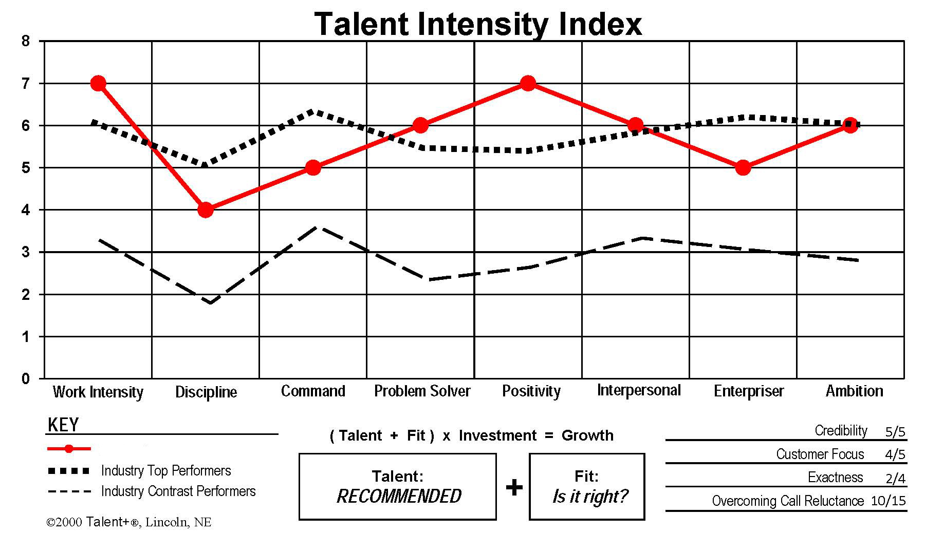
This is what Sonia has to work with. Anything else is wishful thinking.
S
Jeremy
46

Slide 96
This is what Sonia has to work with. Anything else is wishful thinking.
Lots of energy, works hard, can confuse activity with productivity.
S
Jeremy
46

Slide 97
This is what Sonia has to work with. Anything else is wishful thinking.
Trouble organizing and prioritizing undermines his focus, often wastes time.
S
Jeremy
46

Slide 98
This is what Sonia has to work with. Anything else is wishful thinking.
Can build a logical case, but avoids confrontation of any sort.
S
Jeremy
46

Slide 99
This is what Sonia has to work with. Anything else is wishful thinking.
Creative, full of ideas, makes beautiful PPTs, loves to learn, seeks coaching.
S
Jeremy
46

Slide 100
This is what Sonia has to work with. Anything else is wishful thinking.
Optimistic/enthusiastic, must feel good about relationship before taking next step.
S
Jeremy
46

Slide 101
This is what Sonia has to work with. Anything else is wishful thinking.
Relationship-driven, team-oriented, needs to feel heard and understood.
S
Jeremy
46

Slide 102
This is what Sonia has to work with. Anything else is wishful thinking.
Calls on smaller accounts, has trouble asking for big dollars.
S
Jeremy
46

Slide 103
This is what Sonia has to work with. Anything else is wishful thinking.
Goal-directed, wants to win, wants team to win.
S
Jeremy
46

Slide 104
Jeremy’s powerful relationship talents cause as much trouble as benefit.
In the field, Sonia sees the same problems over and over…
So focused on relationship, too often he can’t move forward.
Super-optimistic, he bounces back, not stopping to consider...
Avoids confrontation, unwilling to risk any relationship.
Wastes time—disorganized, puts relationship over potential.
S
Jeremy
46

Slide 105
Without nurturing and mentoring, Jeremy’s strong Positivity and Interpersonal were causing more problems than advantages.
Interpersonal is not usually a motivation theme, for Jeremy it is his #1 reason not to act. Sonia’s plan is to turn that around and make it his #1 reason to act.
Many salespeople are not team-oriented, but Jeremy very much is. Sonia shows Jeremy how his failure to move prospects and clients forward results in him letting his teammates down. She does this consistently—because it works!
Sonia has shown Jeremy that, when he calls on accounts worth only $500, he is earning only $7 an hour. Doing so is letting down both his young family and his teammates.
M
Sonia

Slide 106
Sonia also taps into Jeremy’s very strong Work Intensity… as an additional method to overcome his reluctance to ask people to take action.
Sonia works with Jeremy to determine specific action steps to move business forward and then challenges him to accomplish them by a specific date.
This is working because Jeremy likes feeling productive and likes pleasing Sonia.
M
Sonia

Slide 107
People with softer Discipline often maintain low standards—about how they spend their time, which prospects they target, and their overall productivity.
Sonia rarely misses her weekly 1-on-1 with Jeremy… where they review his weekly work plan, make sure the priorities are right, and create specific next steps for every important piece of business.
Sonia knows this is a weekly commitment—and that Jeremy is not likely to get much better at this—but it’s an hour very well invested for the return she’s getting.
M
Sonia

Slide 108
Jeremy’s Problem Solver talent is a notable strength… but Sonia sees that it needs honing.
Further, Jeremy’s never-ending optimism causes him to grow too fond of the first idea he develops for a client—and as a result, too many of his proposals are dead on arrival.
Sonia taps his powerful Interpersonal theme to show him how to partner and collaborate with prospects… so that poor ideas are eliminated early and promising ones are perfected with the prospect’s help.
M
Sonia

Slide 109
Performance turnaround!
In the six months prior to Sonia’s coaching intervention, Jeremy developed zero new Key Accounts. In the six months following, he developed six!
Jeremy’s Q1 2010 revenue was 50% higher than Q1 2009. And Q2 is pacing 20% ahead.
Jeremy is currently leading the team that is working with a local hospital on a $400,000 proposal… something that would have been impossible a year ago.
S
Jeremy
M
Sonia

Slide 110
Melissa was mired in the $10-12,000 revenue range under the previous manager.
She was tough to manage and largely just left to fend for herself.
M
Barbara
S
Melissa
Barbara recognized Melissa’s giant talents. She also understood that Melissa is the classic prima donna… worth the trouble only if she’s really worth the trouble.

Slide 111
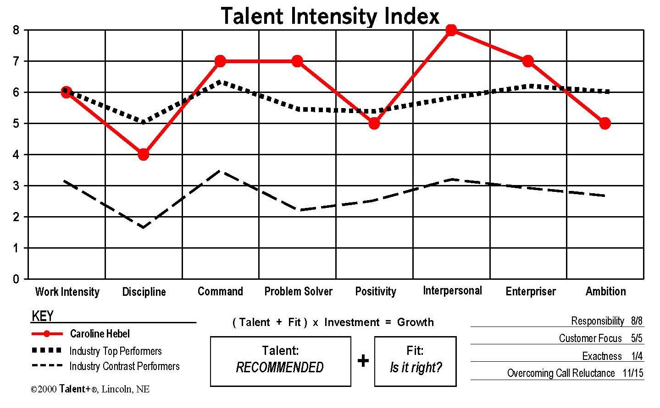
This is what Barbara has to work with. Anything else is wishful thinking.
S
Melissa
46

Slide 112
This is what Barbara has to work with. Anything else is wishful thinking.
Hard working, but her workstyle is dominated by her softer Discipline.
S
Melissa
46

Slide 113
This is what Barbara has to work with. Anything else is wishful thinking.
Struggles to prioritize and juggle multiple projects, needs reminders.
S
Melissa
46

Slide 114
This is what Barbara has to work with. Anything else is wishful thinking.
Gains commitments quickly and easily, gets a huge thrill from closing.
S
Melissa
46

Slide 115
This is what Barbara has to work with. Anything else is wishful thinking.
Generates new ideas easily, is eager to learn and try new things.
S
Melissa
46

Slide 116
This is what Barbara has to work with. Anything else is wishful thinking.
Her Positivity is neither a strength nor a weakness.
S
Melissa
46

Slide 117
This is what Barbara has to work with. Anything else is wishful thinking.
Eager to please, needs lots of time with manager, responds to empathetic approach.
S
Melissa
46

Slide 118
This is what Barbara has to work with. Anything else is wishful thinking.
Does whatever will get public praise, is derailed by micro-mgt, wants investment.
S
Melissa
46

Slide 119
This is what Barbara has to work with. Anything else is wishful thinking.
Not a source of motivation for her.
S
Melissa
46

Slide 120
You would think that these two themes would guarantee a lot of deals done.
S
Melissa
46

Slide 121
…but Melissa has an even stronger pair of themes that’s really in control.
High-strung prima donna!
Here’s what Barbara has to deal with…
Powerful closer—but needy, sensitive “showboater.”
Poor with details, keeping multiple balls in the air, prioritizing.
Craves independence, but needs help with weekly work plan.
Needs to target better, higher-value prospects.
S
Melissa
46

Slide 122
Barbara understands she’ll need to “walk a tightrope” with Melissa, who needs frequent management attention but hates to be micro-managed.
Step One was to invest a lot of personal time with Melissa. This signaled appreciation and fondness… and it built the relationship that would be the foundation for everything else Barbara hoped to accomplish.
M
Barbara

Slide 123
With the relationship established, Barbara could start to focus on business issues—what it would take to move to a dramatically higher revenue level.
To avoid being seen as a micro-manager, Barbara holds her opinions back.
She moves conversations forward by asking questions, not making statements.
M
Barbara

Slide 124
Barbara succeeded in getting Melissa to set an ongoing monthly revenue goal of $50,000.
As Barbara asked more questions—about the activity level necessary to achieve that goal—Melissa herself determined that she needed three projects a week to accomplish… as well a weekly follow-up meeting.
Only after all that groundwork was established could Barbara get into the details of helping Melissa select better prospects, prioritize her work, and plan her daily tasks.
M
Barbara

Slide 125
Barbara continues to invest more time with Melissa than with others on the staff. She’s decided it’s worth it.
Melissa loves the attention and does not consider it micro-management.
The trust bond is so solid now that Melissa readily asks for help when she needs it, something that would not have happened before.
M
Barbara

Slide 126
Performance turnaround!
After working this plan for about a year, there was no question in Barbara’s mind that it was worth it.
Melissa zoomed past all 31 other salespeople in the division to sell not only the most new Target Accounts, but also the greatest total dollars in new Target accounts.
Her monthly revenue reached an average of $41,000, about 4 times what it had been.
Melissa continues to grow: Her Q1 2010 is 27% ahead of Q1 2009.
S
Melissa
M
Barbara

Slide 127
M
Susan
M
Henry
S
Jon
M
Tony
S
Chandra
S
Carol
M
Barbara
M
Sonia
S
Melissa
S
Jeremy

Slide 128
Five talented salespeople.
Five smart managers who know how to turn talent into performance.

Slide 129
Nature | x | Nurture | = | Productivity
8 | x | 2 | = | 16
Nature | x | Nurture | = | Productivity
2 | x | 8 | = | 16
Nature | x | Nurture | = | Productivity
8 | x | 8 | = | 64

Slide 130
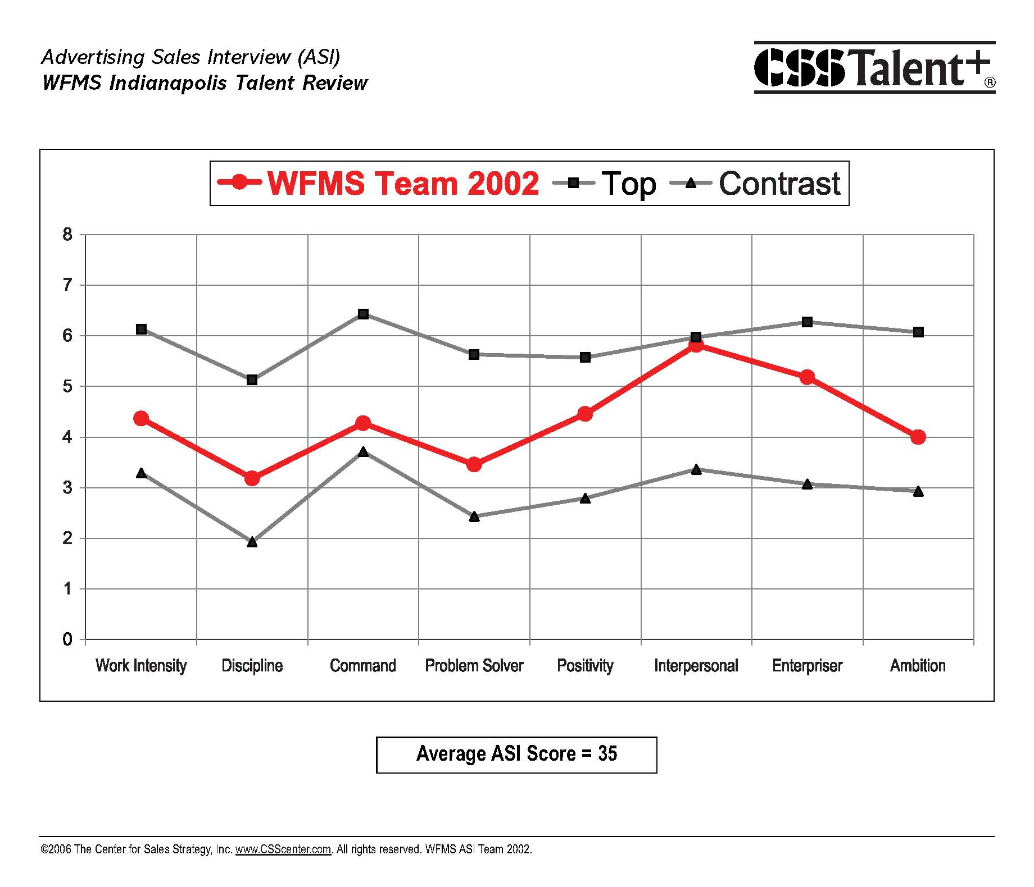

Slide 131
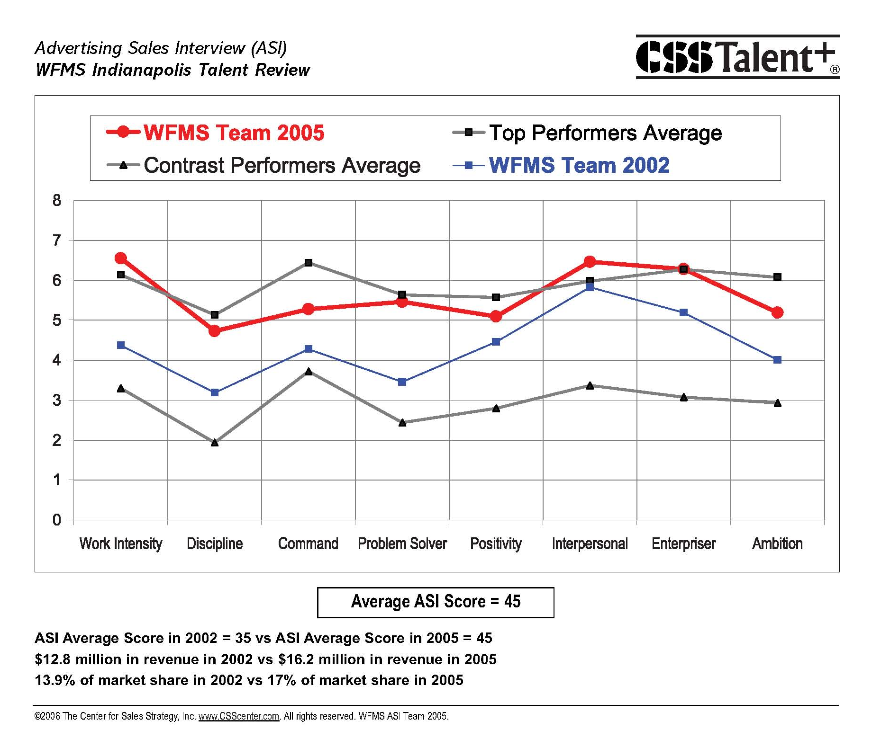

Slide 132
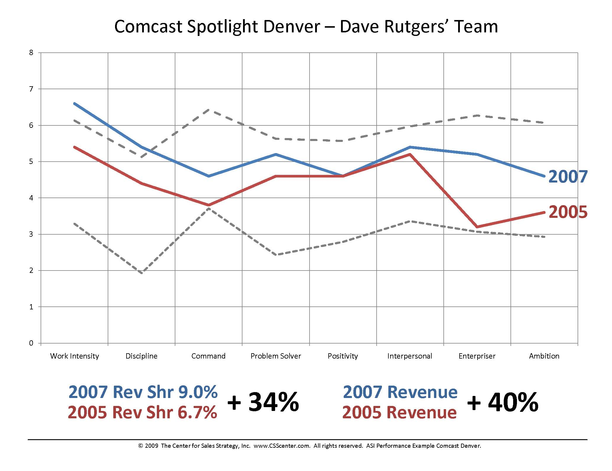

Slide 134
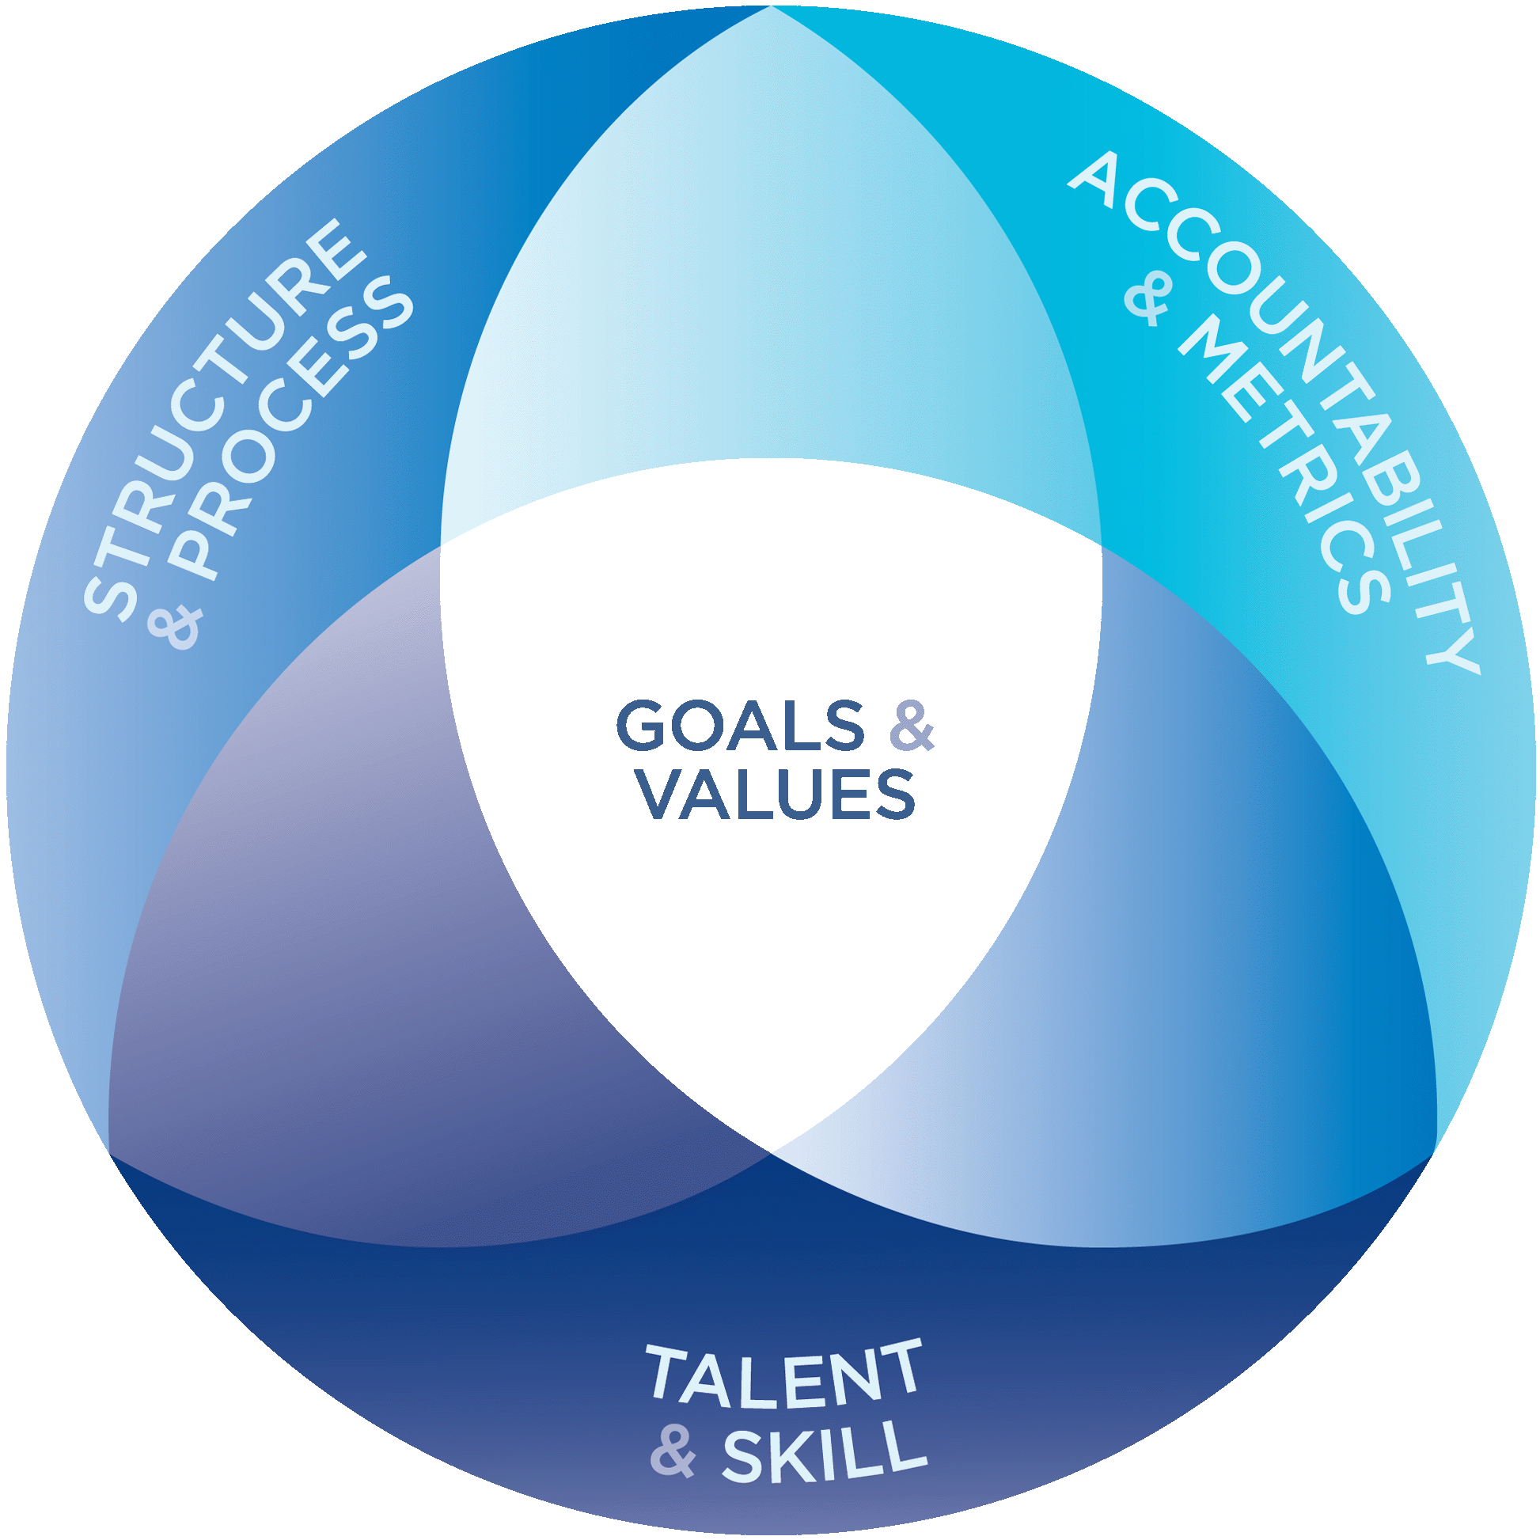
The CSS Performance Prism.

Slide 135
Performance Prism
A prism separates light into its component colors.
The Performance Prism separates the enlightened sales organization into its components.

Slide 136
Goals & Values
Goals = Outcomes you seek.
Values = Beliefs, standards, and principles you choose to follows as you pursue your goals.

Slide 137
Structure & Process
The “lone wolf” sales model just doesn’t hunt anymore.
Sales organizations need to use the same division of labor concept adopted by manufacturing over a century ago.

Slide 138
Accountability & Metrics
Selecting the right metrics for your sales dashboard is a critical decision.
Metrics are essential not only to monitor performance, but also to provide management with the data stream it needs to fine-tune the Structure & Process.

Slide 139
Talent & Skill
Understanding each person’s unique talent fingerprint allows managers to set appropriate expectations for each individual. As the performance of each person is maximized, so is that of the organization.
Sales skill training has a much greater impact when delivered to the right people fitted to the right jobs.

Slide 140
The CSS Performance Prism.

Slide 141
Talent
Turning Talent into Performance

Slide 142
Muchas gracias.
SteveMarx@CSScenter.com

